Slide 1
1984 Literary Terms
English 12

Slide 2
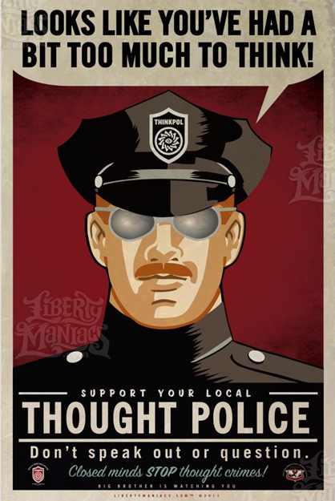
1984 Literary Terms
SATIRE :
Satire is a genre of literature that uses wit for the purpose of social criticism. Satire ridicules problems in society, government, businesses, and individuals in order to bring attention to certain follies, vices, and abuses, as well as to lead to improvements. Irony and sarcasm are often an important aspect of satire.

Slide 3
Forms of Satire

Slide 4
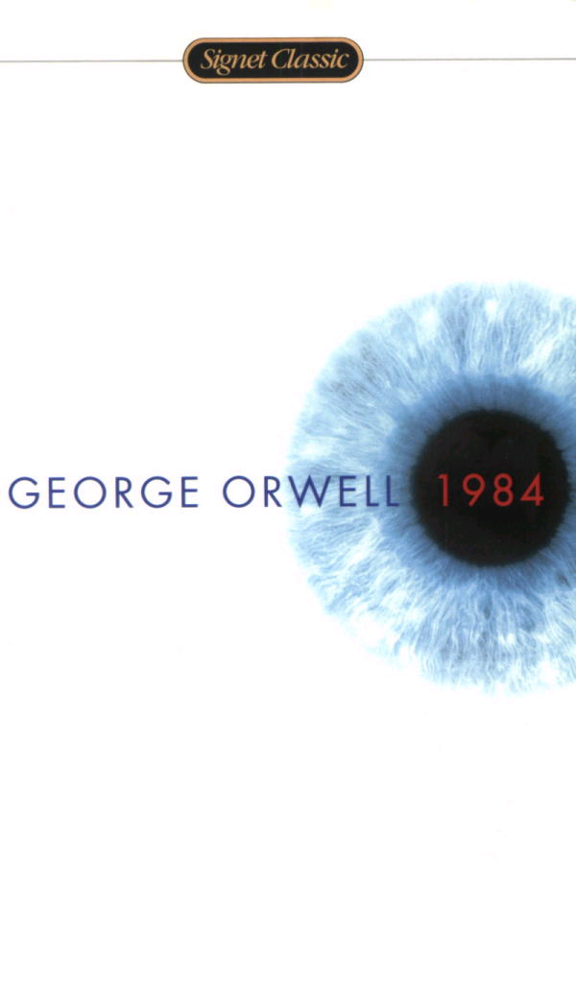
1984 Literary Terms
Irony is a figure of speech in which the actual intent is expressed in words which carry the opposite meaning. For example, in Julius Caesar, Antony insists that, “Brutus is an honorable man.”

Slide 5
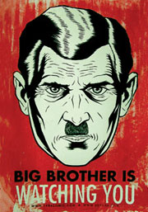
1984 Literary Terms
Parody is a composition humorously imitating another, usually serious, piece of work. Parody in literature is like caricature in art.

Slide 6
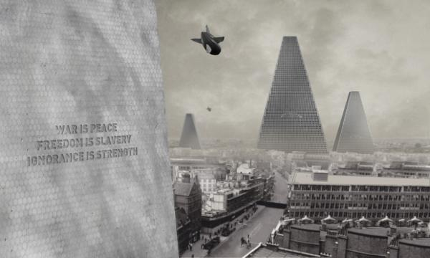
1984 Literary Terms
Sarcasm is verbal irony that pretends to praise, but intends to show bitter and personal disapproval. Sarcasm is personal, jeering and intended to hurt.

Slide 7

1984 Literary Terms
Innuendo is an insinuation or indirect suggestion with a harmful or sinister connotation.

Slide 8

1984 Literary Terms
Invective is harsh or abusive language directed against a person or cause.

Slide 9
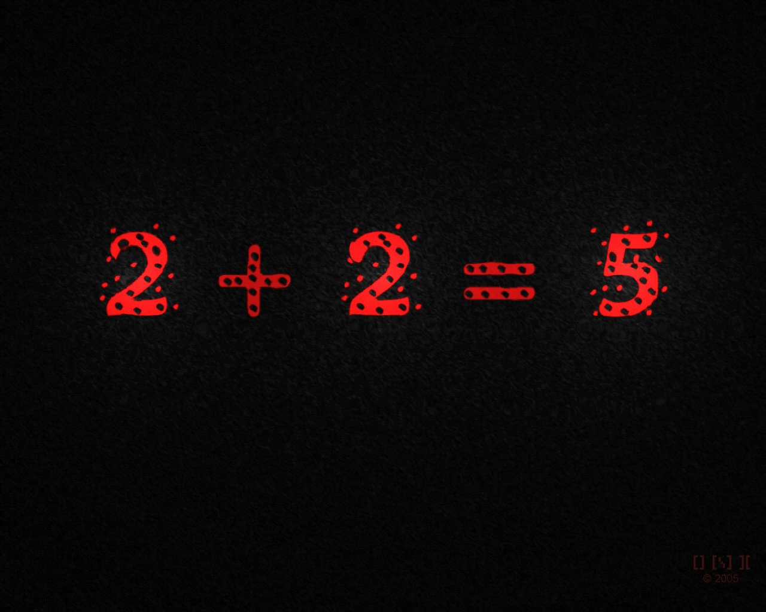
1984 Literary Terms
Burlesque is a form of comic art characterized by ridiculous exaggeration.

Slide 10

1984 Literary Terms
SYMBOLISM
When used as a literary device, symbolism means to imbue objects with a certain meaning that is different from their original meaning or function. Other literary devices, such as metaphor, allegory, and allusion, aid in the development of symbolism. Authors use symbolism to tie certain things that may initially seem unimportant to more universal themes. The symbols then represent these grander ideas or qualities. For instance, an author may use a particular color that on its own is nothing more than a color, but hints at a deeper meaning

Slide 11

1984
FLASHBACK:
In literature, a flashback is an occurrence in which a character remembers an earlier event that happened before the current point of the story. There are two types of flashbacks—those that recount events that happened before the story started and those that take the reader back to an event that already happened but that the character is considering again

Slide 12
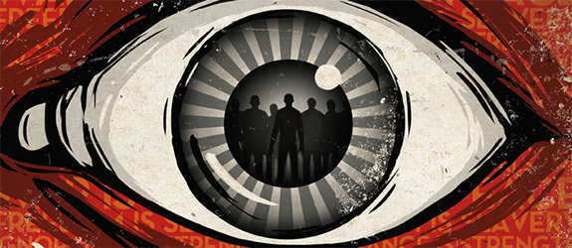
1984 Literary Terms
FORESHADOWING: Foreshadowing is a literary device in which the author gives clues about events that will happen later in the story. Often these clues are fairly subtle so that they can only be noticed or fully understood upon a second reading. Foreshadowing can come in the form of descriptive detail, such as storm clouds on the horizon, bits of dialogue, and even in the names an author gives character.

