Slide 1
Characterization
English 12

Slide 2

Defining Characterization
Direct Characterization
Direct Characterization tells the audience what they personality of the character is.

Slide 3
For Example
The patient boy and the quiet girl were both well mannered and did not disobey their mother.
What words describe the boy and girl?

Slide 4

Indirect Characterization
Indirect characterization shows things that reveal the personality of a character.

Slide 5

Indirect Characterization
There are five different methods to show characterization.
Think:
STEAL

Slide 6

S: Speech
What des the character say? How does the character speak?

Slide 7

T: Thoughts
What is revealed through the character’s private thoughts and feelings?

Slide 8
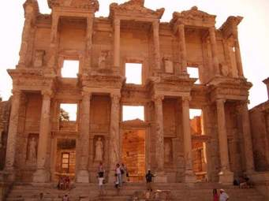
E: Effect on others toward the character
What is revealed through the character’s effect on other people? How do other characters feel or behave in reaction to the character?

Slide 9

A: Actions
What does the character do? How do the characters behave?

Slide 10
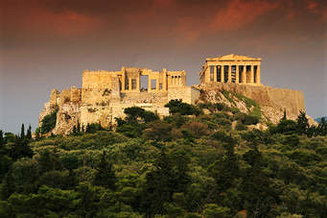
L: Look
What does the character look like?
How does the character dress?

Slide 11

A short video
https://www.youtube.com/watch?v=IRW6yVOHCQc

