Slide 1
Characterization
The Great Gatsby

Slide 2
What is Characterization?
Characterization is the way in which authors share information about their characters.

Slide 3
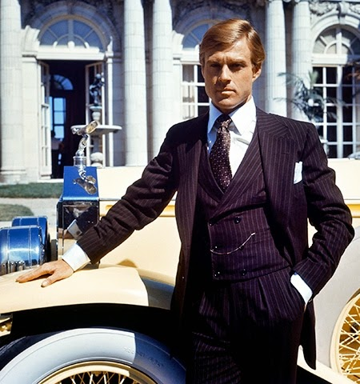
Why is it important?
Characterization is a crucial part of making a story compelling. In order to interest and move readers, characters need to seem real. Authors achieve this by providing details that make characters individual and particular. Good characterization gives readers a strong sense of characters' personalities and complexities; it makes characters vivid, alive and believable.

Slide 4
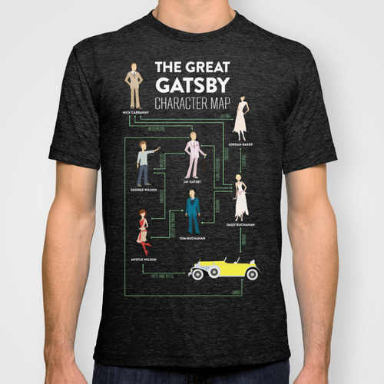
Authors use characterization to….
Portray a character’s thoughts and motivations.

Slide 5
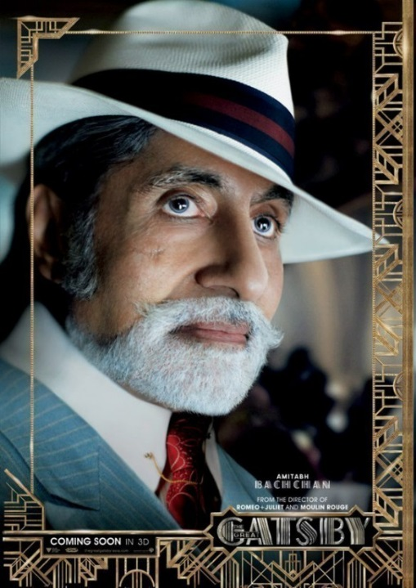
Authors use characterization to….
In dialogue to allow a character’s words to reveal something important about his or her nature.

Slide 6
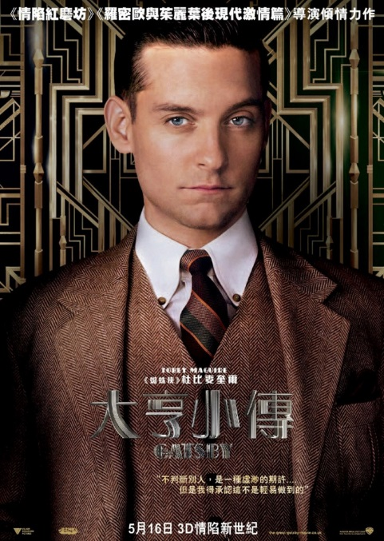
Authors use characterization to….
allow a character’s actions to reveal his or her personality.

Slide 7
Authors use characterization to….
Show others’ reactions to the character or person they are portraying.

Slide 8
Direct characterization
Direct Characterization tells the audience what the personality of the character is.

Slide 9
Indirect characterization
Indirect Characterization shows things that reveal the personality of a character.

Slide 10
Types of indirect characterization
There are five different methods of indirect characterization:
Speech What does the character say? How does the character speak?
Thoughts What is revealed through the character’s private thoughts and feelings?
Effect on others toward the character. What is revealed through the character’s effect on other people? How do other characters feel or behave in reaction to the character?
Actions What does the character do? How does the character behave?
Looks What does the character look like? How does the character dress?

Slide 11
Ask yourself these questions when trying to understand characterization:
What does the character look like?
How does the character behave towards others? How do others behave toward the character?
What does the character seem to care about?
What adjectives does the author use to describe the character's personality?
What does the character think or say?

