Slide 1
Conjugating Verbs
Deutsch I Kapitel 2-1

Slide 2
Conjugating a verb
In German, just like in English, all verbs must be conjugated. This means that they fit together.
So far we have learned to conjugate sein.

Slide 3
Regular Verbs
The verb sein is irregular. This means it does not follow any patterns.
Fortunately, the majority of verbs in German are regular!
That means they follow a pattern.
vs.
Irregular verbs

Slide 4
Here is how you conjugate a verb:
spielen- to play
Ich spiele wir spielen
du spielst ihr spielt
er/sie/es spielt sie spielen
Sie spielen

Slide 5
Here are the steps….
Step 1:
Find the stem of the verb. That means you take off the –en (sometimes, just
the –n)

Slide 6
Step 2:
Look at the subject of the sentence and decide what the correct ending of the verb would be.

Slide 7
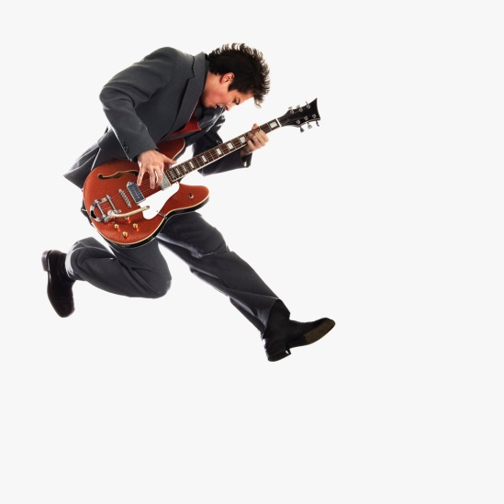
Step 3:
Add that ending…

Slide 8
Step 4:
Put the verb in the second spot for a simple sentence.

Slide 9
More about Verbs
Sometimes there are special circumstances when a regular verb has to have an adjusted ending.

Slide 10
Case #1
One of the cases is when the stem ends in a “d” or a “t” or an “n”
You add an “e” between the stem and the ending in the second and third person.
(it makes it easier to say)

Slide 11
Some of these verbs
Finen and zeichnen.
These changes are in the du and er, sie, and es.
The word would look like this:
Du zeichnest
Er zeichnet
Du findest
Sie findet
Zum Beispiel:

Slide 12
More about verbs….
Another circumstance is when the infinitive form of the verb does not end
in –en
An example of this kind of verb is basteln and another would be segeln.

Slide 13
Zum Beispiel:
In this case, you can drop the “e” from the stem, but only in the ich form.
Ich bastle
Ich segle
The stem is bastel
The stem is segel

