Slide 1
Word Order
Deutsch I Kapitel 2-3

Slide 2
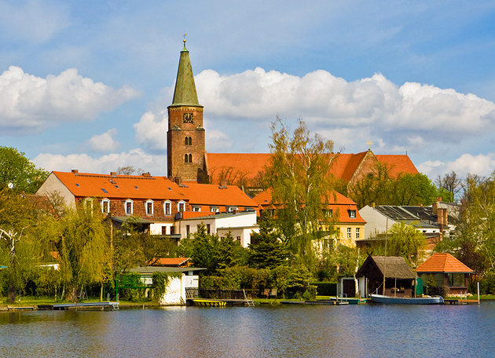
Word Order
Word order is the position of words in the sentence.

Slide 3
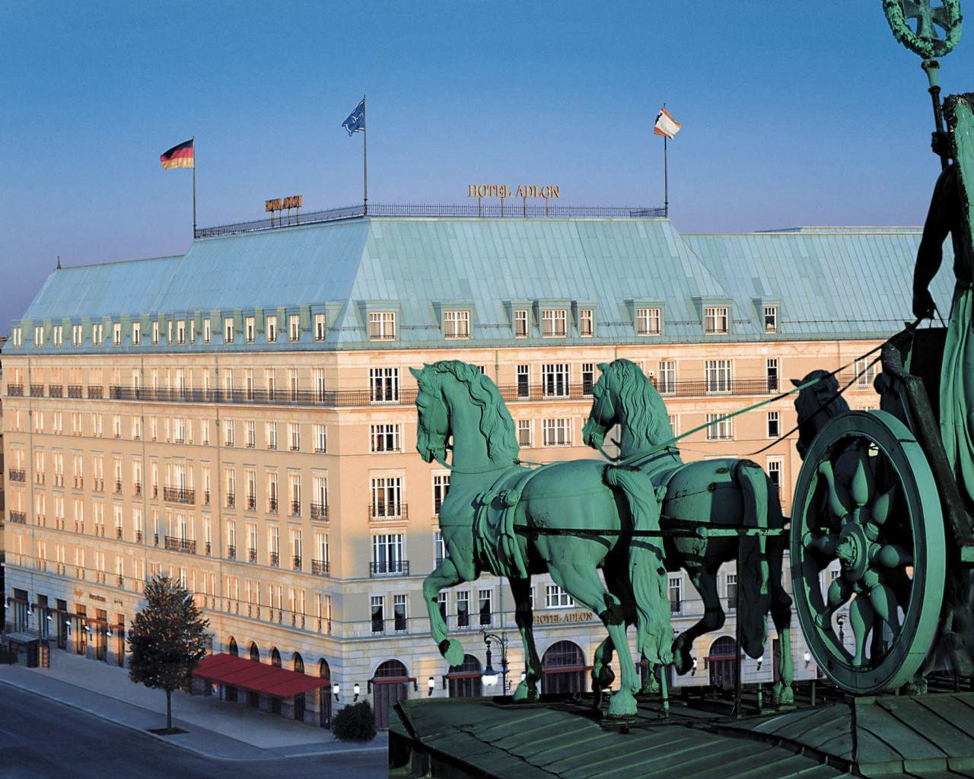
Word order
In German, the subject does not always need to be first.

Slide 4
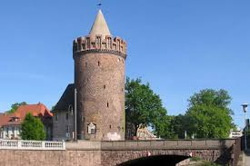
Word order
The firm rule is that the verb is ALWAYS, ALWAYS, ALWAYS is in the second position in a simple sentence.

Slide 5
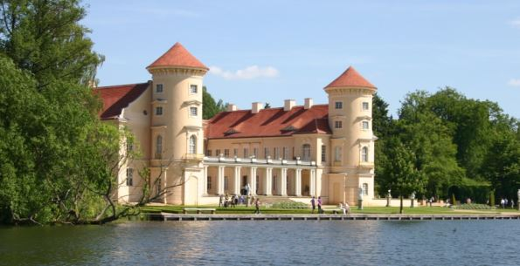
Word order
In German, you can put the topic you want to emphasize first for effect.

Slide 6
Zum beispiel:
Wir spielen nach der Schule Fußball.
(a standard simple sentence)

Slide 7
Word order
Wir: Subject
spielen: verb
nach der Schule: time expression
Fußball: object

Slide 8
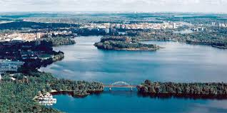
Word order
Time first:
Nach der Schule spielen wir Fußball.
I want to emphasize the time.

Slide 9
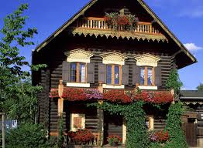
Word order
Fußball spielen wir nach der Schule.
( I want to emphasize that we are playing football)

Slide 10
Word order
Nach der Schule spielen wir Fußball.
NO COMMAS!!!!!

Slide 11
Word order
The general rule is
Subject + verb + Time +Manner + Place
(TeMPo)

Slide 12
Word order
If something besides the verb comes first, the subject must be as close to the verb as possible. (Right behind it)

