Slide 1
The Possessives

Slide 2

The Possessives
A possessive is a type of article that shows ownership.

Slide 3
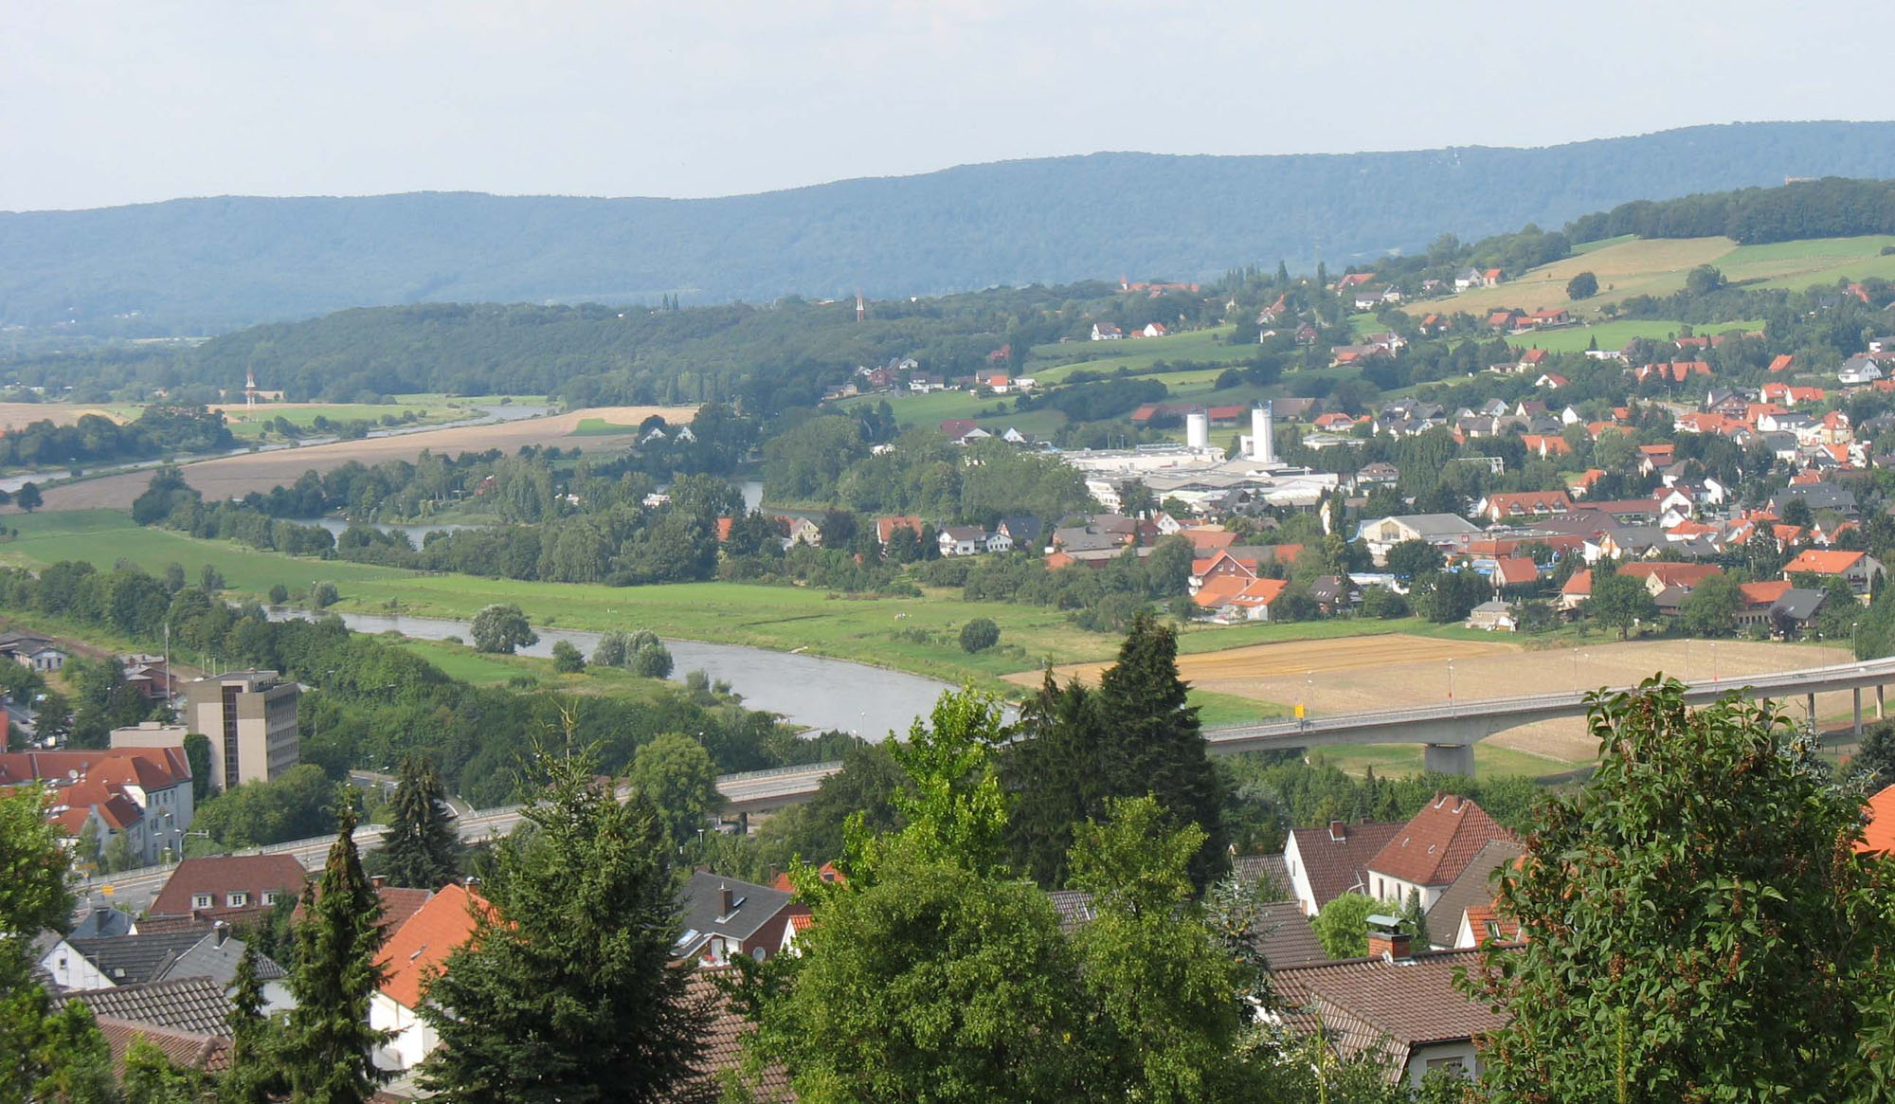
The Possessives
In English, these are words like my and your, his and her.

Slide 4

The Possessives
In German, the possessive article is determined by the gender of the noun
AND
Who has ownership.

Slide 5

The Possessives
Englisch | Deutsch
my | mein
your | dein
his | sein
her | ihr
its | sein

Slide 6

The Possessives
They also have endings.
They are part of the indefinite articles.

Slide 7
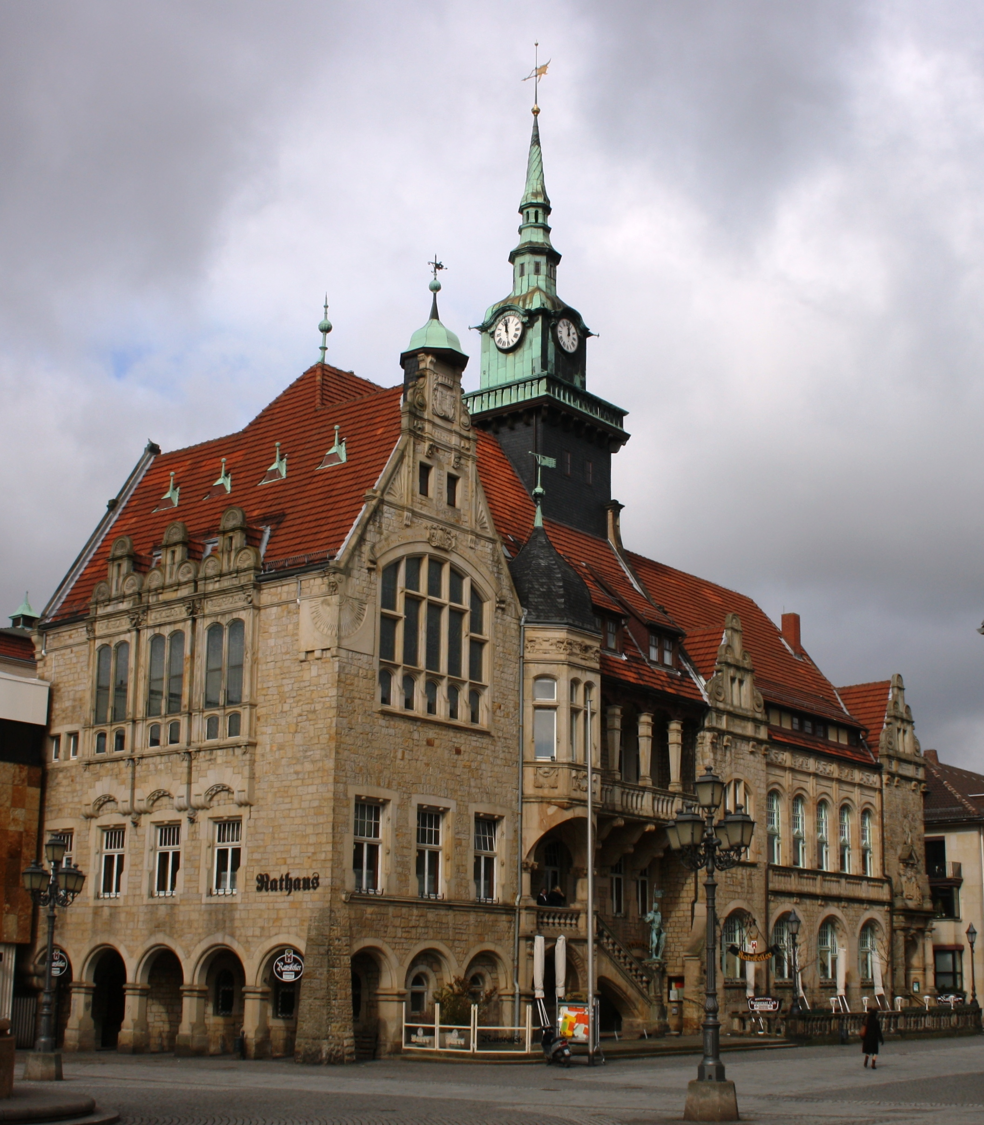
The Possessives
They use the same endings as the indefinite articles.

Slide 8
The Chart!
 | Nominative | Accusative | Dative
Masculine | mein, dein, sein, ihr
Feminine | Meine, deine, seine, ihre
Neuter | mein, dein, sein, ihr
Plural | meine, deine, seine, ihre

Slide 9

Zum Beispiel
Mein Auto ist kaputt.
Deine Schwester ist 10 Jahre alt.
Ihr Vater heißt Ingo.
Seine Mutter heißt Kristina.

