Slide 1
What is Irony?

Slide 2
Irony
It’s funny!
It’s unexpected.
It sometimes creates suspense.
It’s like Cupid never falling in love.

Slide 3
What is Irony?
We have discussed how literature is a way for writers to share a message with the reader. Just how are the authors we will be studying getting their message across? Irony is just one of the writing tools an artist uses to sharpen his or her point.

Slide 4
The Big Picture
Irony
Verbal
Irony
Situational
Irony
Dramatic
Irony

Slide 5
Three Types of Irony
1. Verbal irony is when an author says one thing and means something else.
2. Dramatic irony is when an audience perceives something that a character in the literature does not know.
3. Situational irony is a difference between what is expected and what happens

Slide 6
Verbal Irony
The simplest kind of irony.
You use it everyday when you say one thing and really mean another.
It is often similar to a sarcastic response.
Examples:
  When you appear to be sick and someone asks you if you’re okay. You say “Of course!” But in the meantime you are vomiting and fainting.
  Your boyfriend shows up in ripped up jeans and a stained t-shirt. With a smirk, you say, "Oh! I see you dressed up for our date. We must be going to a posh restaurant."
http://www.youtube.com/watch?v=PUadZ6ALU0M

Slide 7
Situational Irony
Occurs when a situation turns out to be the opposite of what you thought it would be.
Examples:
  The teacher’s daughter is a High School drop out.
  The mayor’s wife gets caught stealing.
  The chef won’t eat his/her own cooking.
  The barber always needs a hair cut himself.
  You break a date with your girl friend so you can go to the ball game with the guys. When you go to the concession stand, you run into your date who is with another guy.
  You stay up all night studying for a test. When you go to class, you discover the test is not until the next day.
http://www.youtube.com/watch?v=Nm-1xvWibt0

Slide 8
Dramatic Irony
Occurs when the audience knows something that the characters in the story, on the screen, or on the stage do not know. It’s like the audience is more aware of what’s going on than the people in the production.
This is used to engage the audience and keep them actively involved in the storyline.

Slide 9
Dramatic Irony continued…
In all of the Friday the 13th movies, we know Jason is in the woods. The characters do not. When they go out into the woods we are afraid for them because we know that they are in danger. We scream for them to run, we get excited when they fall, we cringe when we know that Jason is right behind the tree.
When watching a talk show, the audience knows why a person has been brought on the show. However, the person sitting in a chair does not know that he is going to be reunited with a former lover. This adds to the suspense and humor of the show.
http://www.youtube.com/watch?v=EP-1kt92vqY

Slide 10
Review
Irony is a kind of a surprise. It is the difference between what is expected to happen, and what actually does happen.
Irony is like a glitch, a twist, or a last minute switch in the game. It is an interruption of events that cause an unexpected outcome.
There are three types of irony: Verbal, Situational, Dramatic

Slide 11
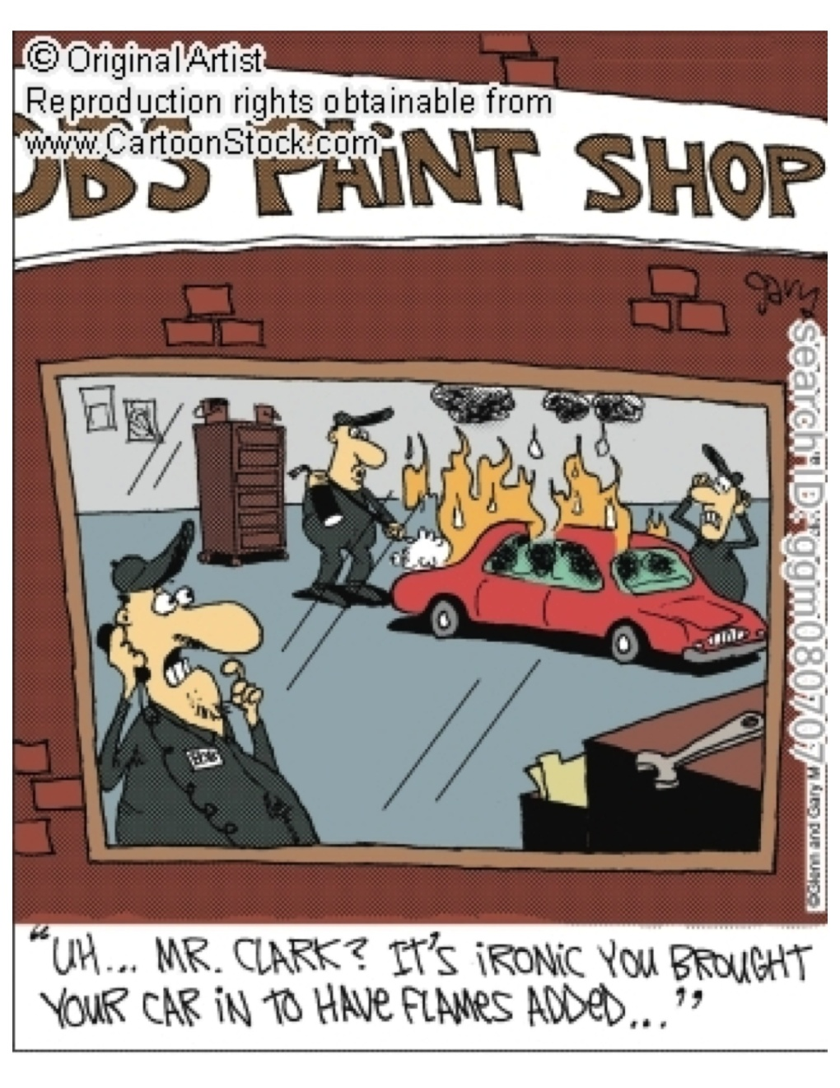
Which Type of Irony?

Slide 12
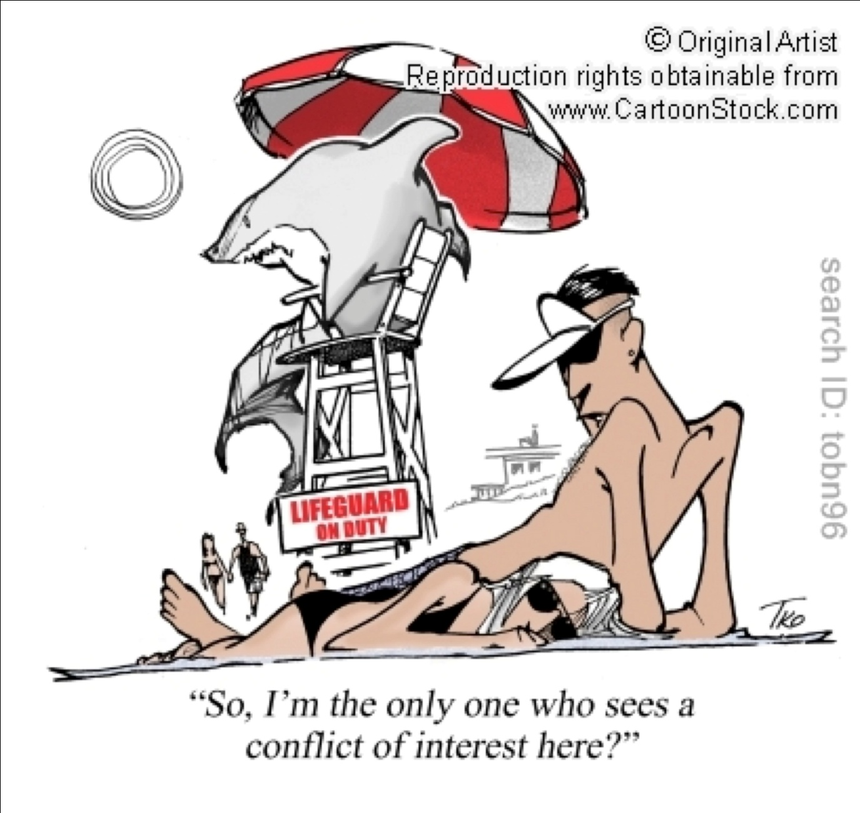
Which Type of Irony?

Slide 13
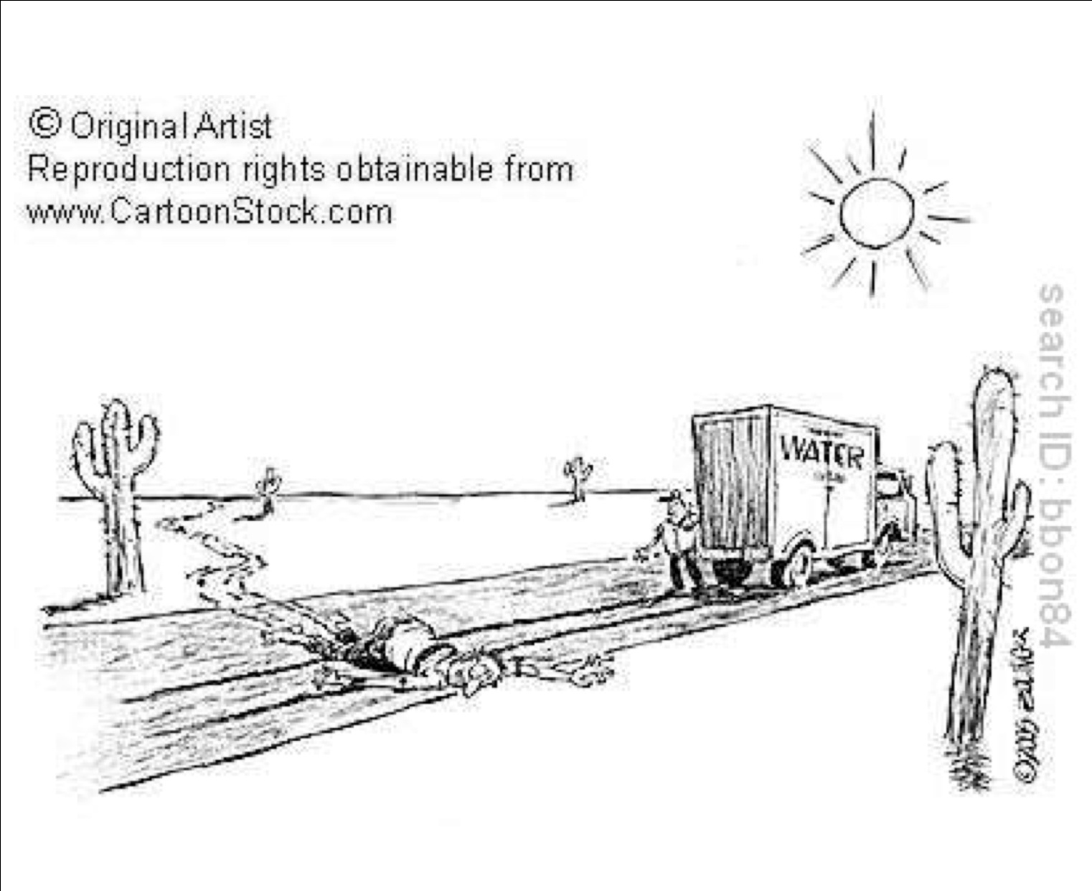
Which Type of Irony?

Slide 14
Applying Irony to “Twilight”
________ Irony:
Bella wants to know how Edward tracked her to Port Angeles. He says, “Your scent.” She doesn’t know what to make of that, but the readers knows that he’s telling the truth.
________ Irony:
Bella – “How long have you been 17?”
Edward – “A while.”
________ Irony:
Bella learns Edward is a vampire. Instead of being frightened she is intrigued.

