Slide 1
Meine Postkarte
Further instructions

Slide 2
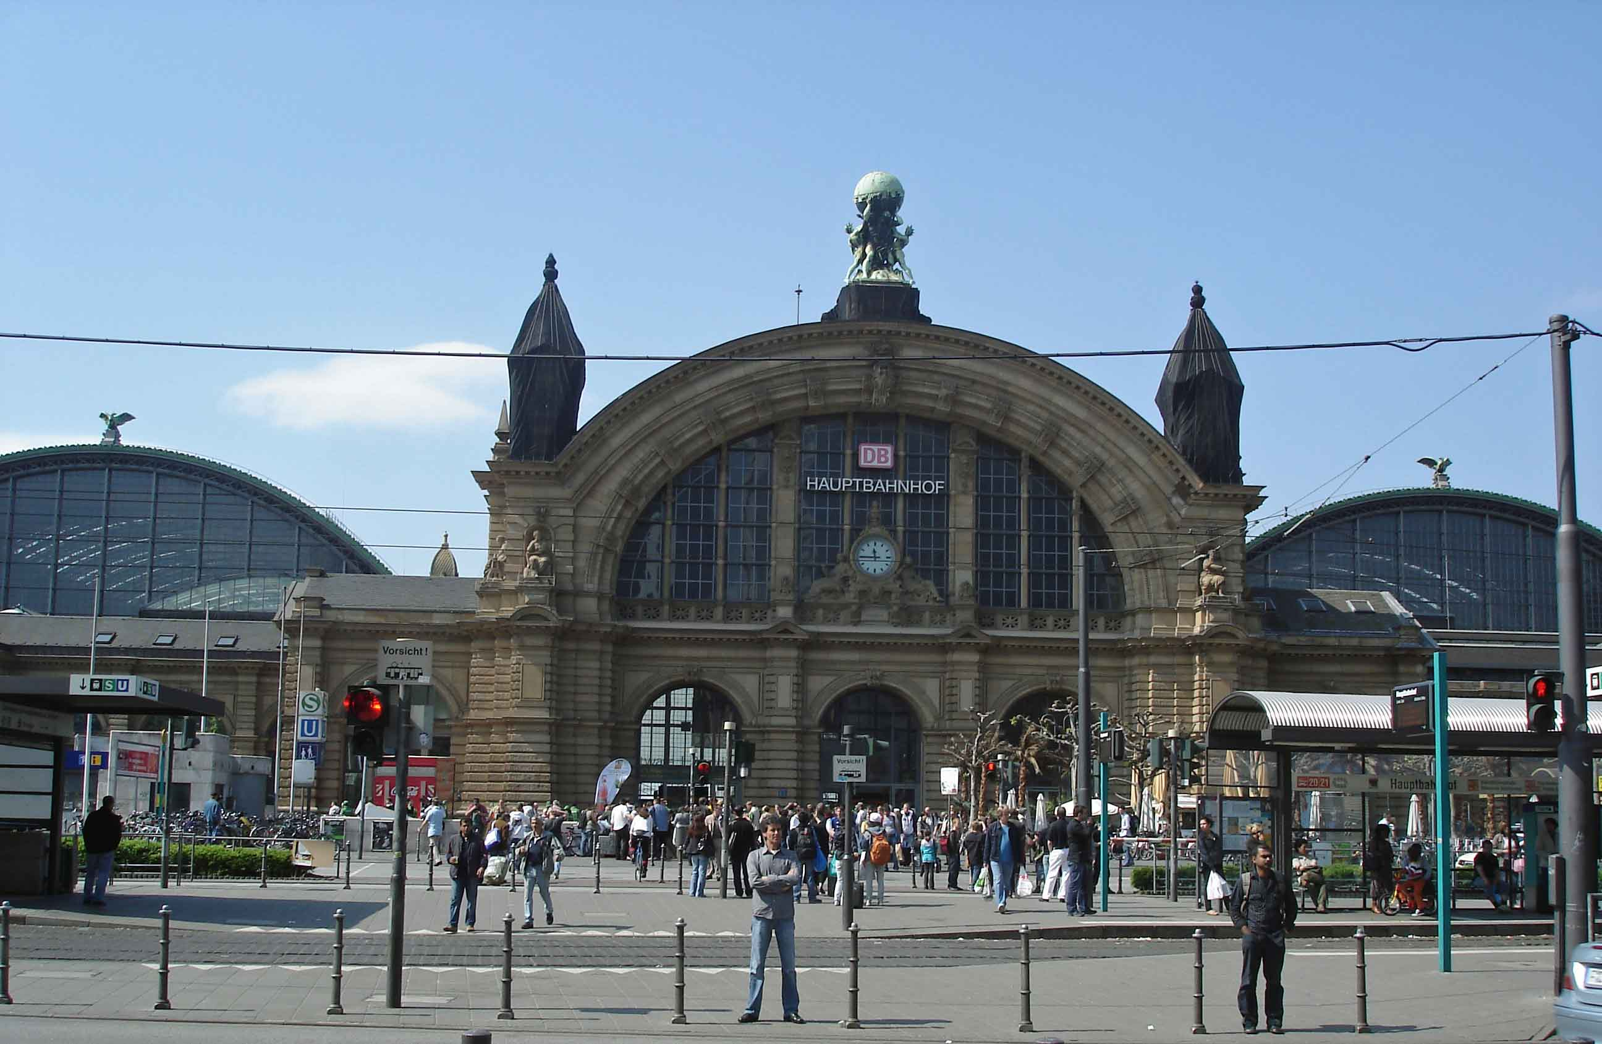
Now….
Circle all verbs-make a list
Identify which tense
What is the infinitive of the verb
Identify adjective endings
Identify nouns
Identify gender of the nouns
Identify case of nouns, explain why

