Slide 1
MLA Format and Citations
Note: A great website is Owl Purdue, Citation machine, and citation monster

Slide 2
MLA Format
Margins should be 1 inch all around
12 point, Times New Roman, double-spaced font
Include a header with your last name and page number justified right
Include in the upper left hand corner your name, instructor’s name, class, and date (23 March 2016)
Remember: for titles of longer works such as novels, the title is written in italics, whereas, titles of shorter works such as articles are placed in quotation marks.

Slide 3
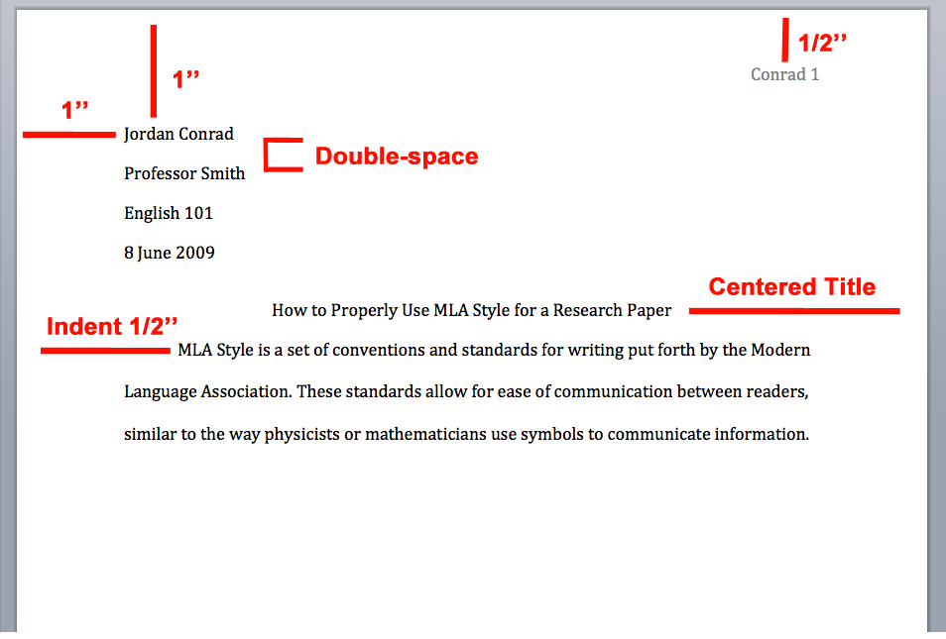
Example First Page

Slide 4
In-text Citations
Books
(Author’s last name page #)
Example: “The truth was that Jay Gatsby of West Egg, Long Island, sprang from his Platonic conception of himself” (Fitzgerald 98).

Slide 5
In-text Citations
Articles
(Author’s last name page number)
Page numbers are included unless the article does not have page numbers listed on the bottom of the page.
Example: “The American Dream is a concept that was and still remains at the very foundation of the United States of America” (Smith 34).

Slide 6
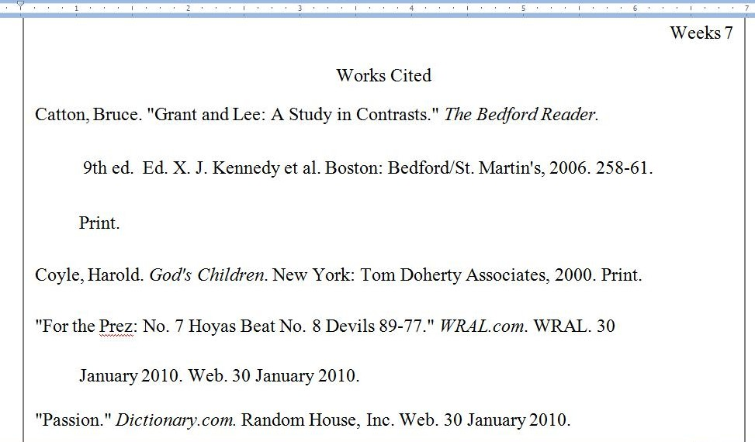
Works Cited Page Example

Slide 7
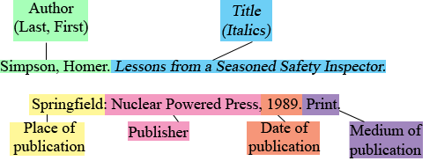
Works Cited Books

Slide 8
Works Cited Articles

