Slide 1
Mood and Tone
English 12

Slide 2
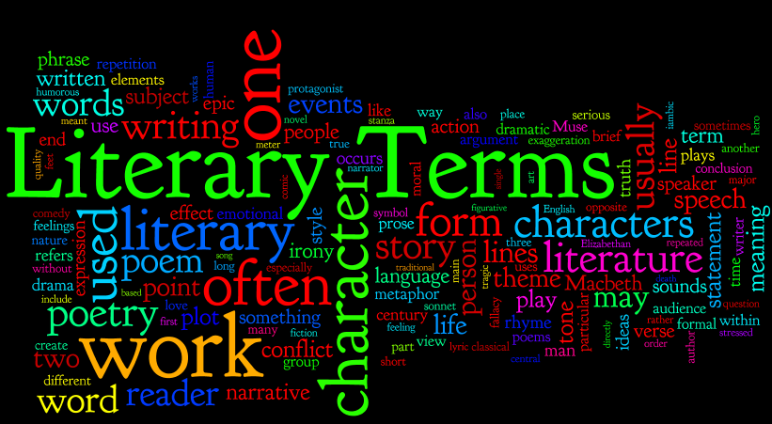
What is tone?
Tone and mood both deal with the emotions centered around a piece of writing. Though they seem similar and can in fact be related causally, they are in fact quite different.

Slide 3
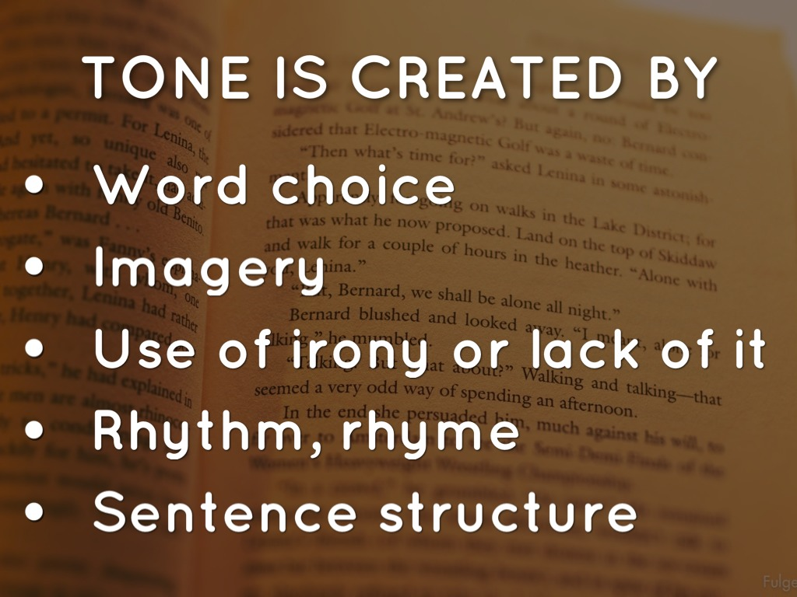
What is tone?
Tone is the author’s attitude toward a subject. While journalistic writing theoretically has a tone of distance and objectivity, all other writing can have various tones.

Slide 4
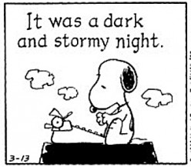
What is tone?
If we were to read a description of a first date that included words and phrases like “dreaded” and “my buddies forced me to go on the date”, we could assume that the individual didn’t really enjoy the date.

Slide 5
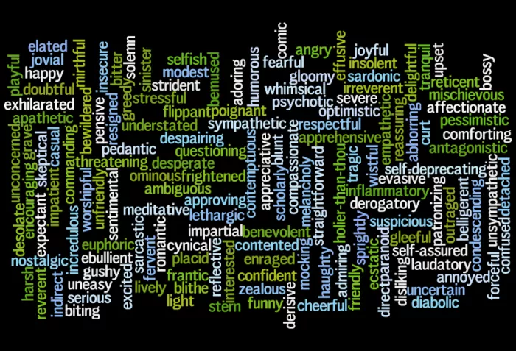
Tone words

Slide 6
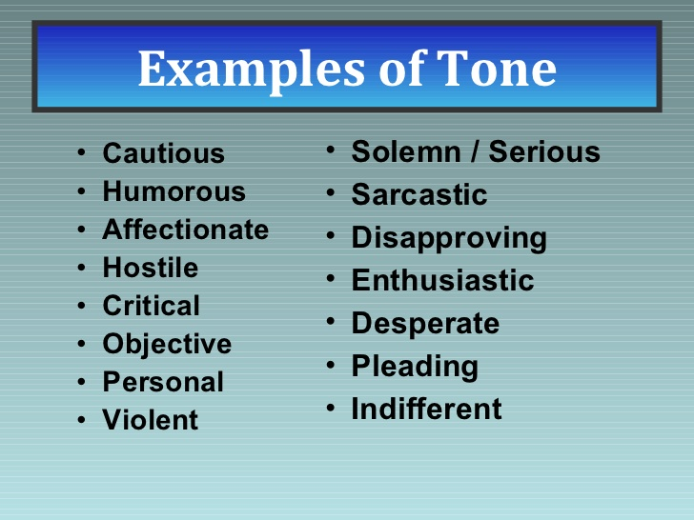
More tone words
\\00-staff01\staffhome$\KAMMANNLM\Desktop\tone words.docx

Slide 7
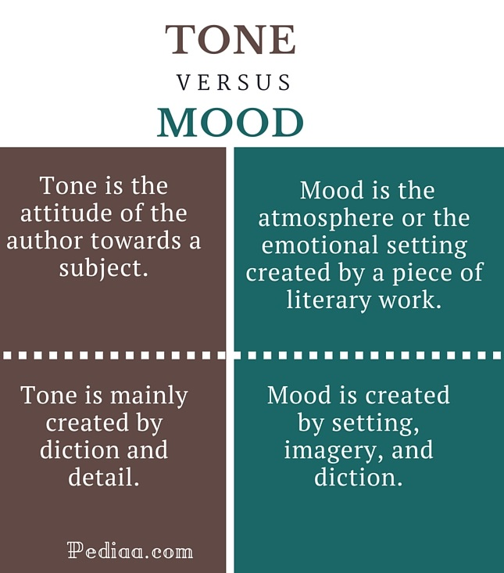
What is mood?
Mood is the atmosphere of a piece of writing; it’s the emotions a selection arouses in a reader.

Slide 8
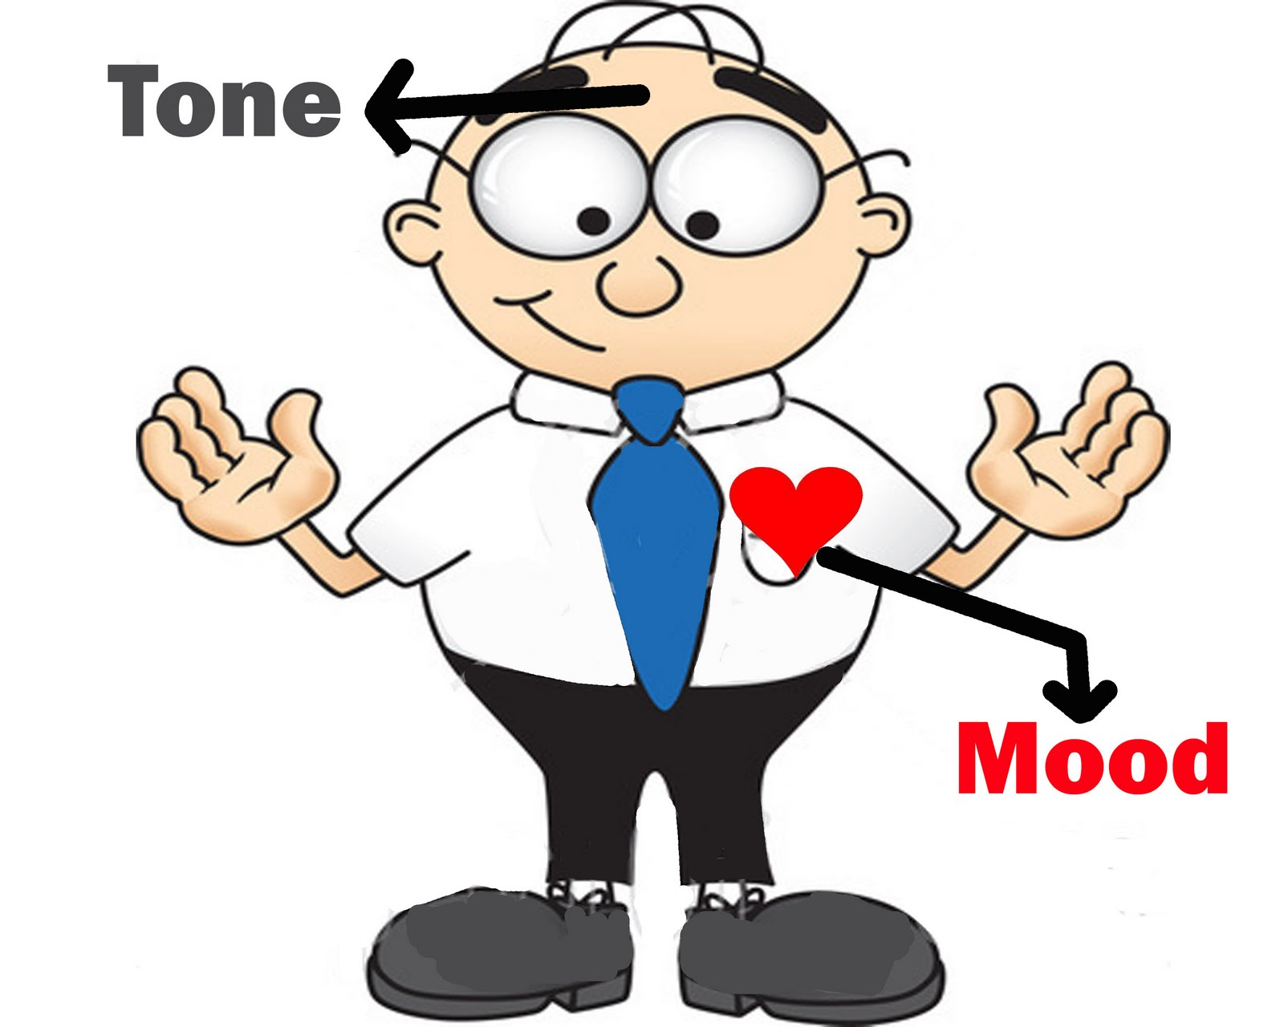
What is mood?
One good way to see mood (and, to a degree, tone) in action is through genre-crossing movie trailers. In film editing classes, a common assignment is to take an existing film and create a film preview that presents the film as a different genre.

Slide 9
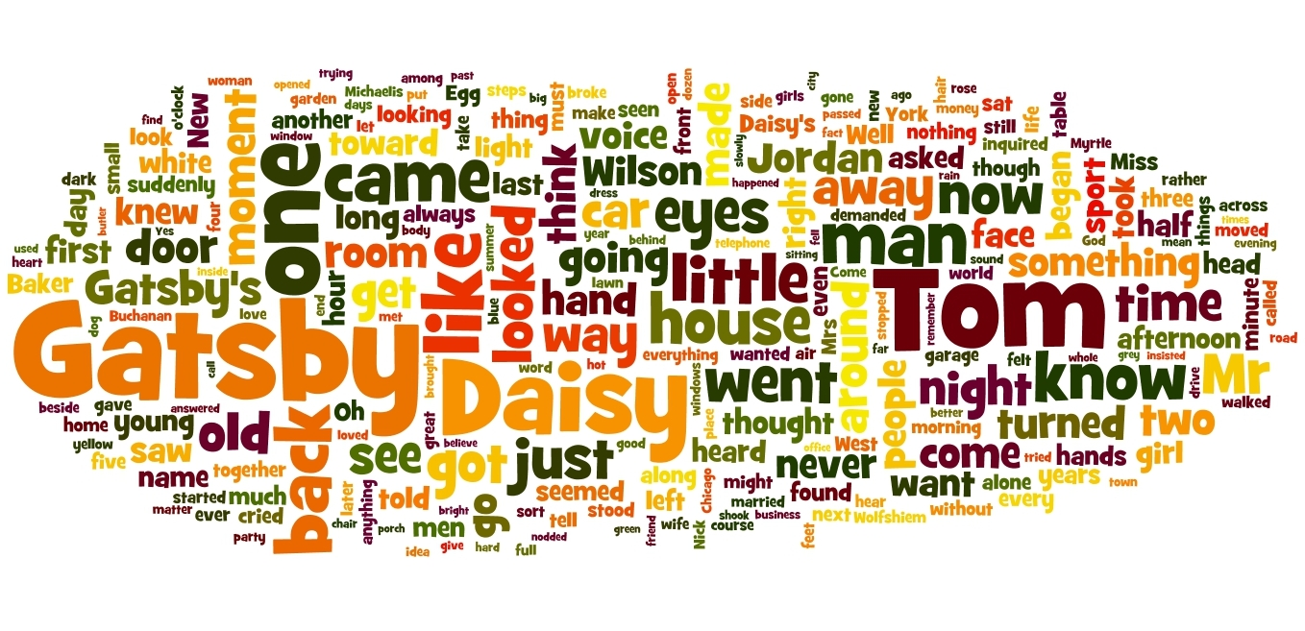
What is mood?
This is accomplished through editing and splicing scenes, adding new, anxiety-producing music and sound effects, and adding a new voice-over introduction.

Slide 10
Frozen as a horror film
https://youtu.be/9eD2UpdhbwA?t=11

Slide 11
More mood words
\\00-staff01\staffhome$\KAMMANNLM\Desktop\mood words.docx

Slide 12
Mary Poppins
http://ourenglishclass.net/wp-content/uploads/sites/6/2009/10/marypoppins1.mp4?_=1

Slide 13
The Shining
http://ourenglishclass.net/wp-content/uploads/sites/6/2009/10/shining.mp4?_=3

