Slide 1
The American Dream

Slide 2
a national ethos of the United States, the set of ideals (Democracy, Rights, Liberty, Opportunity, and Equality) in which freedom includes the opportunity for prosperity and success, and an upward social mobility for the family and children, achieved through hard work in a society with few barriers. In the definition of the American Dream by James Truslow Adams in 1931, "life should be better and richer and fuller for everyone, with opportunity for each according to ability or achievement" regardless of social class or circumstances of birth.
The
American Dream
Is…

Slide 3
Part I
You will each receive an article about the American Dream.
You need to read it and annotate. Make sure you have good notes.

Slide 4
Part II
You need to find the person in this room with the same article.
Share your notes and make an oral presentation of your article.

Slide 5
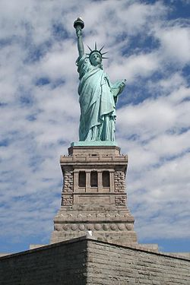
Part II continued
What was the article about?
What did you think?
Do you agree? Why? Why not?
What surprised you?

Slide 6
PART III
Share your article with the class.

Slide 7
Part IV
In the media center, find an article that supports your idea of The American Dream

Slide 8
Part V
Share your article with the class. Make sure to tell us why you chose it and what it is about, who is the author and what source you used.

